Slide 1


Alex T
January 5, 2026

Slide 2

Outline
Executive Summary
Introduction
Methodology
Results
Conclusion
Appendix

Slide 3
Executive Summary
Summary of methodologies:
Data collection using SpaceX API and web scrapping (Wikipedia page with launch data)
Data cleaning and wrangling
Exploratory data analysis using data visualization and SQL
Interactive visual analytics using Folium and Plotly Dash dashboard
Predictive analysis using Scikit-learn (classification)
Summary of all results
Heavier payload result in a higher success rate
KSC LC-39A has the largest number of successful launches and highest success rate
Most predictive models explain 83% of variance in outcomes

Slide 4
Introduction
Background and context
SpaceX is an aerospace and space transportation company. The key part of their approach is to reuse the first stage of a space rocket so that the part can be used for multiple launches thus saving a lot of money and making launch cost much lower. For example, Faclon 9 launch is priced at 62 million dollars which is much lower than other providers’ offering of about 165 million dollars.
If an alternate company wants to bid against SpaceX, they might want to predict launch outcomes and costs based on available data to build their business.
Problems solved in this study
Data collection, data analysis and predictive modeling to estimate launch outcomes based on available public data

Slide 5

Section 1

Slide 6
Methodology
Executive Summary
Data collection methodology:
Using REST API
Using Web scraping
Perform data wrangling
Fixed missing data and converted all outcomes to single training label 0 or 1 (Class)
Perform exploratory data analysis (EDA) using visualization and SQL
Perform interactive visual analytics using Folium and Plotly Dash
Perform predictive analysis using classification models
Selected features and used multiple models
Cross-validation, hyperparameter grid search and score comparison

Slide 7
Data Collection
Two data sources:
SpaceX REST API using Requests library in JSON format
https://api.spacexdata.com
Web scraping using Requests and parsing using BeautifulSoup
https://en.wikipedia.org/wiki/List_of_Falcon_9_and_Falcon_Heavy_launches
SpaceX REST API
Requests
JSON
json_normalize
Pandas
Data Frame
CSV
Wikipedia
Requests
HTML
BeautifulSoup
Parsed data

Slide 8
Data Collection – SpaceX API
spacex_url=https://api.spacexdata.com/v4/launches/past
response = requests.get(spacex_url)
data = pd.json_normalize(response.json())
data_falcon9 = launch_data[launch_data['BoosterVersion']!='Falcon 1’]
…loc[:,'FlightNumber'] = list(range(1, data_falcon9.shape[0]+1))
https://github.com/tepl/coursera-applied-data-science-capstone/blob/main/module-1-introduction/jupyter-labs-spacex-data-collection-api.ipynb
URL
JSON
DataFrame
Filter to include Falcon 9 only
Reset the FlgihtNumber
Replace missing mass (NaN) with mean
Save to CSV
Keeping only relevant features
Extract launch date only, no time

Slide 9
Data Collection - Scraping
static_url = https://en.wikipedia.org/w/index.php?title=List_of_Falcon_9_and_Falcon_Heavy_launches&oldid=1027686922
response = requests.get(static_url, headers=headers)
soup = BeautifulSoup(response.content, 'html.parser’)
html_tables = soup.findAll('table')
https://github.com/tepl/coursera-applied-data-science-capstone/blob/main/module-1-introduction/jupyter-labs-webscraping.ipynb
URL
HTML
BeautifulSoup
soup.findAll(‘table’)
launch_dict
DataFrame
Save to CVS

Slide 10
Data Wrangling
There are multiple different case where the booster did not land successfully. For example, ocean, ground pad, drone ship etc. True or False for success.
Convert all those outcomes into Training Labels with 1 means the booster successfully landed 0 means it was unsuccessful.
All steps:
Calculated the number of launches on each site
Calculated the number and occurrence of each orbit
Calculated the number and occurence of mission outcome of the orbits
Created a landing outcome label Class from Outcome column
https://github.com/tepl/coursera-applied-data-science-capstone/blob/main/module-1-introduction/labs-jupyter-spacex-Data%20wrangling.ipynb

Slide 11
EDA with Data Visualization
Charts plotted:
0. Scatter plot of FlightNumber vs. PayloadMass with color-coded Class (hue,1 success, 0 failure). Helps to see how flight number and payload would affect the launch outcome.
Categorical plot FlightNumber vs LaunchSite with color-coded Class. Helps to see how launch site affect the outcome.
Categorical plot Payload Mass Vs. Launch Site with color-coded Class. Helps to see which sites used which payloads and correlation with outcomes as well.
Bar plot Class vs Orbit type. Helps to check if there are any relationship between success rate and orbit type.
Categorical plot FlightNumber and Orbit type. Helps to see if there is a correlation between flight number and success rate for different orbit types.
Categorical plot Payload Mass and Orbit type. Helps to see if there is a correlation between payload and success rate for different orbit types.
Line plot Date (Year) vs Class. Help to see yearly trend in the success rate.
Variables identified: 'FlightNumber', 'PayloadMass', 'Orbit', 'LaunchSite', 'Flights', 'GridFins', 'Reused', 'Legs', 'LandingPad', 'Block', 'ReusedCount', 'Serial’
Dummy variables: 'Orbit', 'LaunchSite', 'LandingPad', 'Serial’ using one-hot encoding
https://github.com/tepl/coursera-applied-data-science-capstone/blob/main/module-2-eda/edadataviz.ipynb

Slide 12
EDA with SQL
Names of the unique launch sites in the space mission
5 records where launch sites begin with the string ‘CCA’
Total payload mass carried by boosters launched by NASA (CRS)
Average payload mass carried by booster version F9 v1.1
Date when the first successful landing outcome in ground pad was achieved
Names of the boosters which have success in drone ship and have payload mass greater than 4000 but less than 6000
Total number of successful and failure mission outcomes
Booster versions that have carried the maximum payload mass, using a subquery with a suitable aggregate function
Records with the month names, failure landing outcomes in drone ship ,booster versions, launch site for the months in year 2015
Count of landing outcomes (such as Failure (drone ship) or Success (ground pad)) between the date 2010-06-04 and 2017-03-20, in descending order.
https://github.com/tepl/coursera-applied-data-science-capstone/blob/main/module-2-eda/jupyter-labs-eda-sql-coursera_sqllite.ipynb

Slide 13
Build an Interactive Map with Folium
Summary of used map objects added to the map using Folium
Marked all launch sites on a map using Circles and Markers to see locations
Marked the success/failed launches for each site using MarkerCluster to see how successful each site is
Marked proximities using PolyLine and calculated the distances to those proximities
Used MousePosition to find coordinates
https://github.com/tepl/coursera-applied-data-science-capstone/blob/main/module-3-visualization-dashboard/lab_jupyter_launch_site_location.ipynb

Slide 14
Build a Dashboard with Plotly Dash
Summary of plots/graphs in the dashboard
Pie chart of launch success count for all sites to find the most successful site
Pie chart of launch success ratio of the best site to see what the actual ratio is
Scatter plot of payload vs. launch outcome to identify the most successful payload range and booster version.
https://github.com/tepl/coursera-applied-data-science-capstone/blob/main/module-3-visualization-dashboard/spacex-dash-app.py

Slide 15
Predictive Analysis (Classification)
Summary of analysis:
Preprocessing by standardizing the data
Train-set split by 20/80, 20% for test data
Fit multiple models: logistic regression, support vector machine, decision tree classifier and k-nearest neighbors
Using GridSearchCV to find best hyperparameters with cross-validation cv = 10
Prediction and scoring on test data and making a bar chart
Plotting confusion matrix to see how well classification works
https://github.com/tepl/coursera-applied-data-science-capstone/blob/main/module-4-predictive-analysis/SpaceX_Machine%20Learning%20Prediction_Part_5.ipynb

Slide 16
Results
Exploratory data analysis results
Interactive analytics demo in screenshots
Predictive analysis results

Slide 17

Section 2

Slide 18
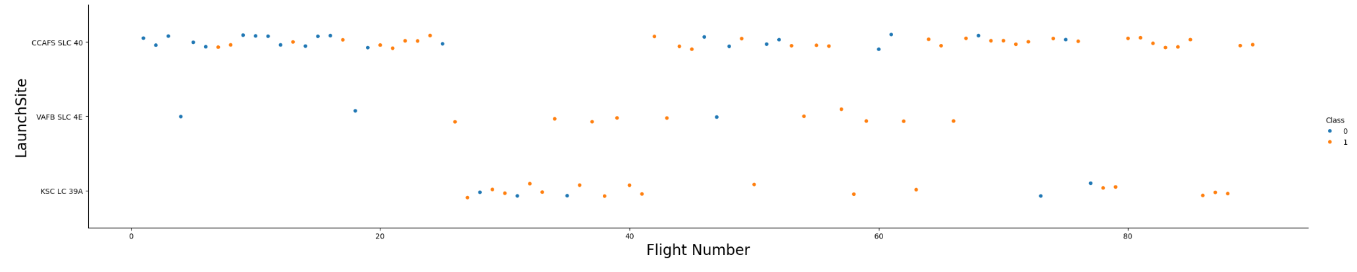
Flight Number vs. Launch Site
CCAFS SLC 40 has many failures especially for low flight numbers
KSC LC 39A does not have low flight numbers.

Slide 19
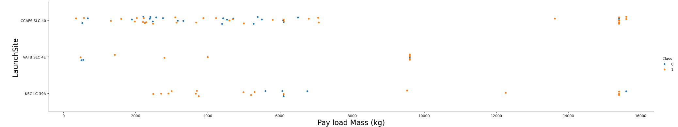
Payload vs. Launch Site
For VAFB-SLC there are no rockets launched for heavy payload mass.
Heavy payloads are more successful.

Slide 20
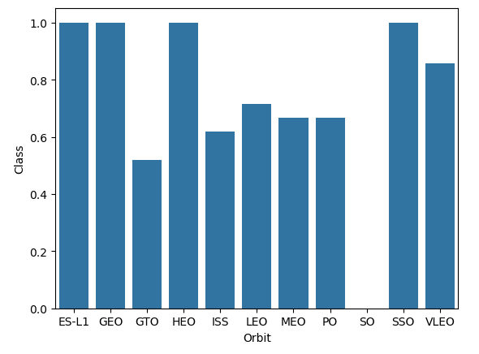
Success Rate vs. Orbit Type
Orbits with highest success rate are ES-L1, GEO , HEO and SSO.

Slide 21
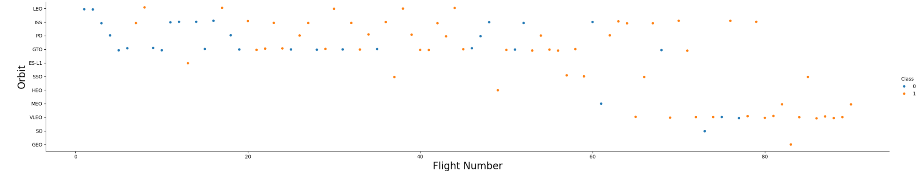
Flight Number vs. Orbit Type
For LEO orbit the success rate correlates with the flight number.
For GTO orbit, there appears to be no relationship between flight number and success.

Slide 22
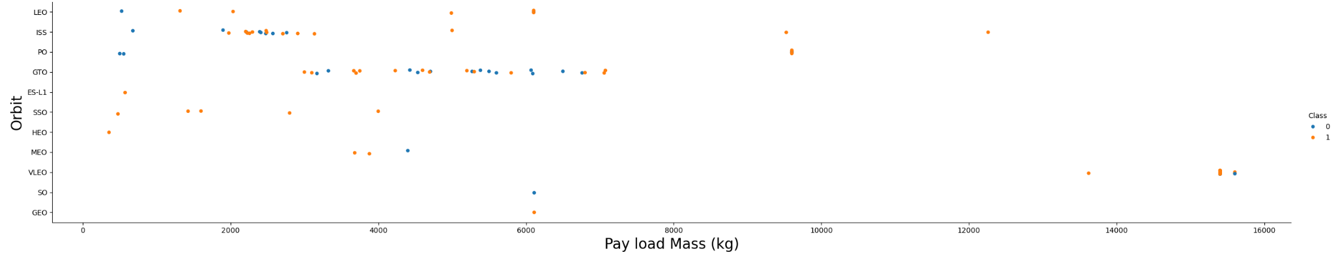
Payload vs. Orbit Type
With heavy payloads the successful landing rate are more for Polar, LEO and ISS.
For GTO, both outcomes are present.

Slide 23
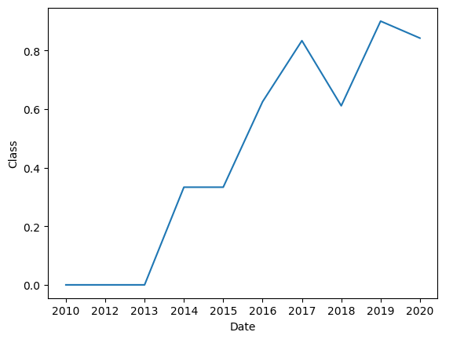
Launch Success Yearly Trend
The success rate since 2013 kept increasing till 2020

Slide 24
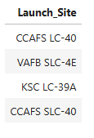
All Launch Site Names
SELECT DISTINCT("Launch_Site") FROM SPACEXTABLE;
There are 4 unique names

Slide 25
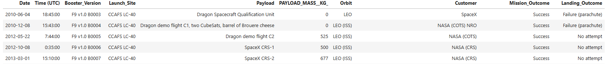
Launch Site Names Begin with 'CCA'
SELECT * FROM SPACEXTABLE WHERE "Launch_Site" LIKE 'CCA%’;
Top 5 CCA launches

Slide 26
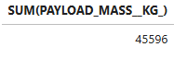
Total Payload Mass
SELECT SUM(PAYLOAD_MASS__KG_) FROM SPACEXTABLE WHERE "Customer" = "NASA (CRS)";
Total payload mass by NASA

Slide 27
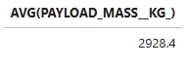
Average Payload Mass by F9 v1.1
SELECT AVG(PAYLOAD_MASS__KG_) FROM SPACEXTABLE WHERE "Booster_Version" = "F9 v1.1";
Average payload mass carried by booster version F9 v1.1

Slide 28
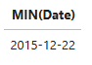
First Successful Ground Landing Date
SELECT MIN(Date) FROM SPACEXTABLE WHERE "Landing_Outcome" = 'Success (ground pad)';
Dates of the first successful landing outcome on ground pad

Slide 29
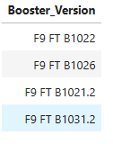
Successful Drone Ship Landing with Payload between 4000 and 6000
SELECT "Booster_Version" FROM SPACEXTABLE WHERE "Landing_Outcome" = 'Success (drone ship)' AND PAYLOAD_MASS__KG_ BETWEEN 4000 AND 6000;
Names of boosters which have successfully landed on drone ship and had payload mass greater than 4000 but less than 6000

Slide 30
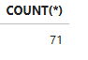
Total Number of Successful and Failure Mission Outcomes
SELECT COUNT(*) FROM SPACEXTABLE WHERE "Landing_Outcome" Like 'Success%' OR "Landing_Outcome" Like 'Failure%';
Total number of successful and failure mission outcomes

Slide 31
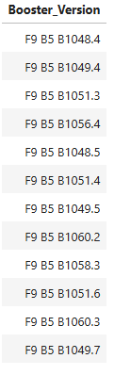
Boosters Carried Maximum Payload
SELECT "Booster_Version" FROM SPACEXTABLE WHERE PAYLOAD_MASS__KG_ = (SELECT MAX(PAYLOAD_MASS__KG_) FROM SPACEXTABLE)
Names of the booster which have carried the maximum payload mass

Slide 32
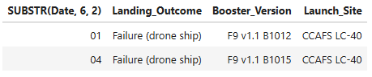
2015 Launch Records
SELECT SUBSTR(Date, 6, 2), "Landing_Outcome", "Booster_Version", "Launch_Site" FROM SPACEXTABLE WHERE "Landing_Outcome" = 'Failure (drone ship)' AND SUBSTR(Date,0,5) = '2015';
Failed landing_outcomes in drone ship, their booster versions, and launch site names for in year 2015

Slide 33
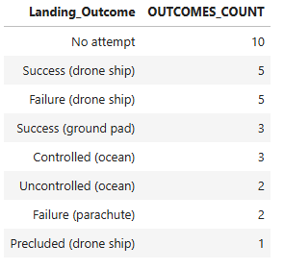
Rank Landing Outcomes Between 2010-06-04 and 2017-03-20
SELECT "Landing_Outcome", COUNT(*) AS OUTCOMES_COUNT FROM SPACEXTABLE WHERE Date BETWEEN '2010-06-04' AND '2017-03-20' GROUP BY "Landing_Outcome" ORDER BY OUTCOMES_COUNT DESC;
Count of landing outcomes (such as Failure (drone ship) or Success (ground pad)) between the date 2010-06-04 and 2017-03-20, in descending order

Slide 34

Section 3

Slide 35
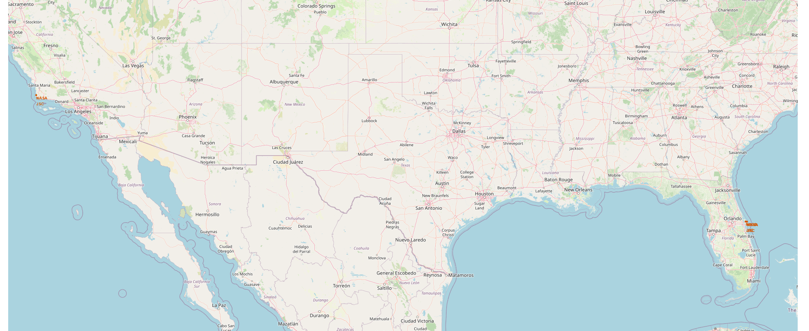
All launch location
There are 4 launch locations
California: VAFB SLC-4E
Florida: CCAFS LC-40, CCAFS SLC-40 and KSC LC-39A

Slide 36
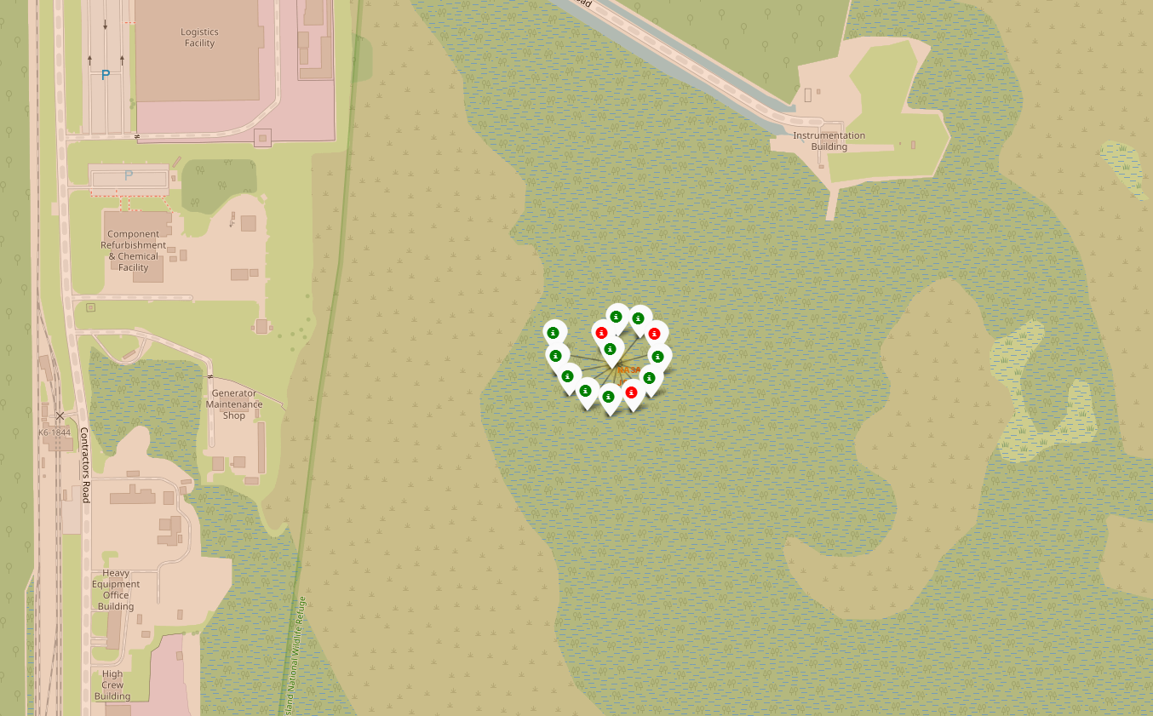
Color-labeled launch outcomes on the map
KSC LC-39A has the highest success ratio (a lot of green markers, only a few are red)

Slide 37
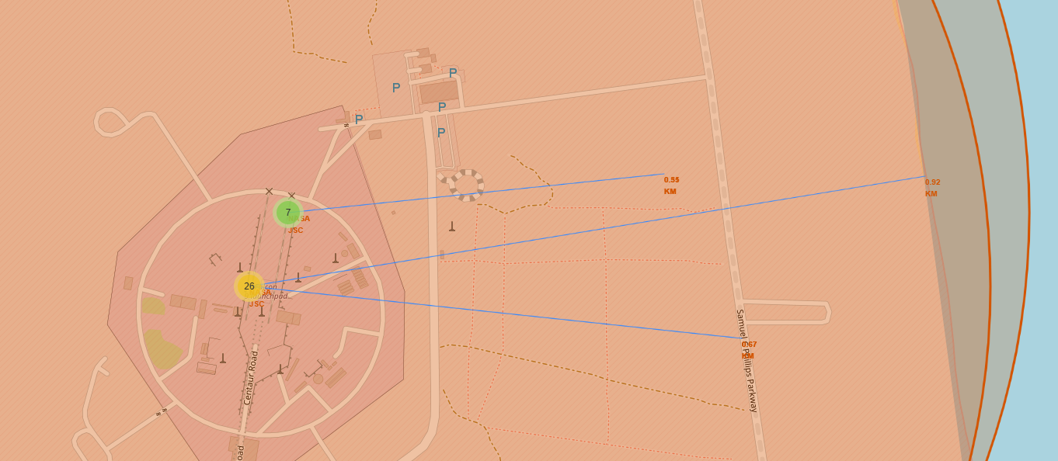
Launch site to its proximities
CCAFS LC-40 proximity examples
To coast line 0.92 KM
To road 0.67 KM

Slide 38

Section 4

Slide 39
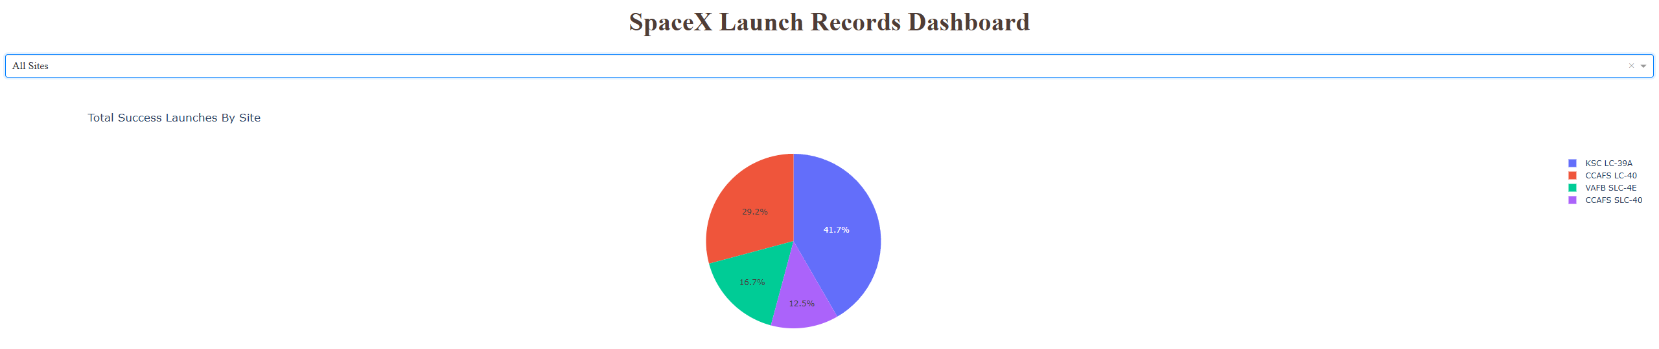
Launch success count for all sites
KSC LC-39A has the highest number of successful launches

Slide 40
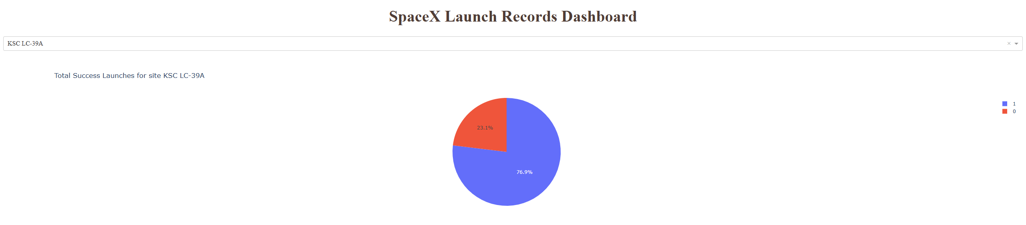
Launch site with highest launch success ratio
KSC LC-39A launch ratio is very high 3:1
A lot of flights were successful, only 23% have failed

Slide 41
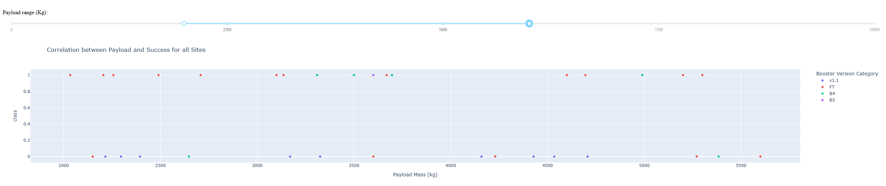
Payload vs. Launch Outcome
In the payload range 2000 – 6000 kg booster version FT has the highest success rate

Slide 42

Section 5

Slide 43
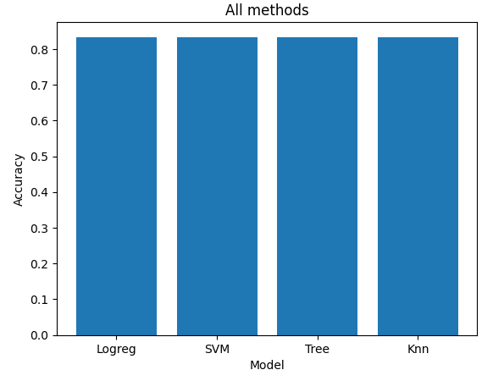
Classification Accuracy
All perform the same on the test data with accuracy of 0.833.
Decision tree classifier seems to do better on the training data then other methods.

Slide 44
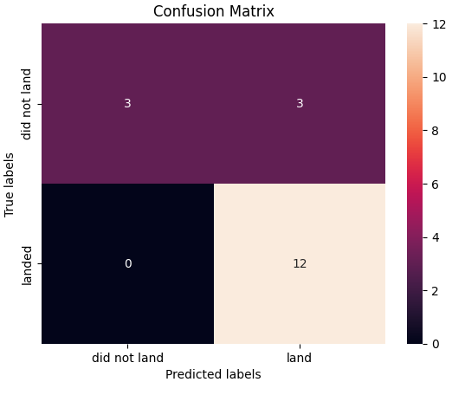
Confusion Matrix
Diagonal elements show how many predicted labels match true labels
[0, 0] True Positives – count 3 (True label is not landed, Predicted label is also not landed)
[1, 1] True Negatives – count 12 (True label is landed, Predicted label is also landed)
Off-diagonal elements how many were predicted incorrectly
[0, 1] False Negatives – count 3 (True label is not landed, Predicted label is landed)
[1, 0] False Positives – count 0 (True label is landed, Predicted label is not landed)

Slide 45
Conclusions
Heavier payload result in a higher success rate
KSC LC-39A has the largest number of successful launches and highest success rate
Most predictive models explain 83% of variance in outcomes

Slide 46
Appendix
All relevant assets like Python code snippets, SQL queries, charts, Notebook outputs, and data sets used in this project can be found on the project Github.
Additional insight
Task8 in Prediction lab has a typo. It says to use ‘auto’ for max_features however DecisionTreeClassifier() does not have auto option and the calculation shows error.
To fix: 'max_features': ['log2', 'sqrt']

Slide 47


